Slide 1
Presentation title and MSA Presenter name
An initiative of the Specialist Services Committee, one of four joint collaborative committees of Doctors of BC and the Government of BC

Slide 2
BIG concept
Bring the attention of your audience to a key concept by using icons or illustrations

Slide 3
Want big impact? Use big image.

Slide 4
Split your content, use fewer words
Column 1
Content here
Content here
Content here
Content here
Column 2
Content here
Content here
Content here
Content here

Slide 5
Use charts / visuals to explain your ideas
White
Grey
Black

Slide 6
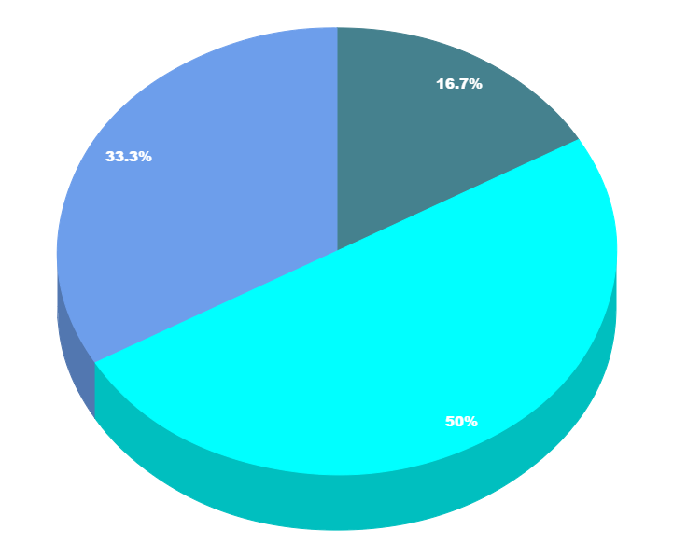
Copy and paste graphs (from Excel, Google sheets, and other graph programs)

Slide 7
Add tables to compare data (can cut and paste from Word)
 | A | B | C
Yellow | 10 | 20 | 7
Blue | 30 | 15 | 10
Orange | 5 | 24 | 16

Slide 8
Illustrate processes
first
second
last

Slide 9
Use big numbers for impact
89,526
Hospital Admissions
544
Physicians engaged

Slide 10
Use quotations from physicians or health authority partners can illustrate positive impacts and inspire further participation.
“
”

